Slide 1
Eniac:
It is beneficial to discount products?
Group 3: Abigail, Cyrus, Daniel and Kalpana
Notes:
Group 3
Our presentation reviewing if It is beneficial for Eniac to discount products.

Slide 2
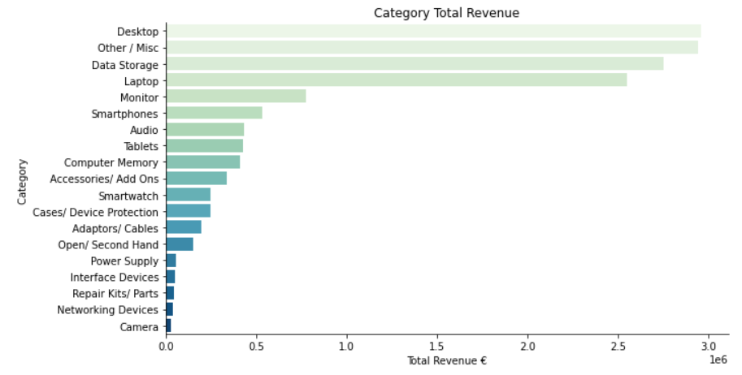
Product Categories
Data Analysis based on completed orders only
Categories:
19 Categories
Top 5 Categories
Desktop - €3.0 mil
Other/ Misc - €2.9 mil
Data Storage - €2.8 mil
Laptop - €2.5 mil
Monitor - €0.8 mil
Limitation
1044 Items added to ‘Other/ Misc’ category
Due to time constraints
Notes:
Firstly, we want to note that all our data analysis is based on completed orders only
We classified our products into 19 categories
Our Top 5 categories by revenue are Desktop, Other/Misc, Data Storage, Laptop and Monitors
A limitation of our data is that due to time constraints we have 1044 items that we were unable to manually categorise so we added them to a Other/Misc category

Slide 3
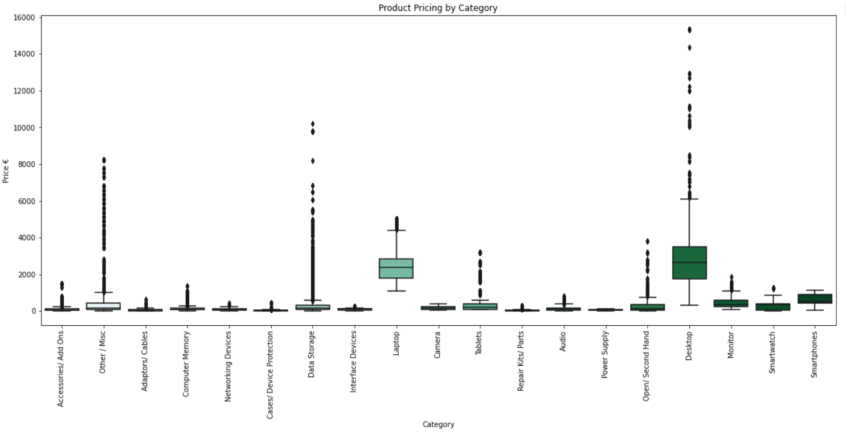
Product Pricing Architecture
Average Price: €461.34
Min Price: €2.99
Max Price: €15,339
Notes:
Looking at our pricing architecture
Average price of all products just under 500 euros, with a min and 2.99 euros and the max at just over 15,000 euros
From the graph we can see there are two high value categories
And three categories with high value outliers
We can also see Desktop and Laptop stand out as categories having a higher average price value vs other areas

Slide 4
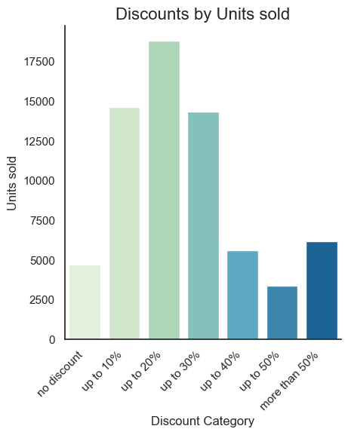
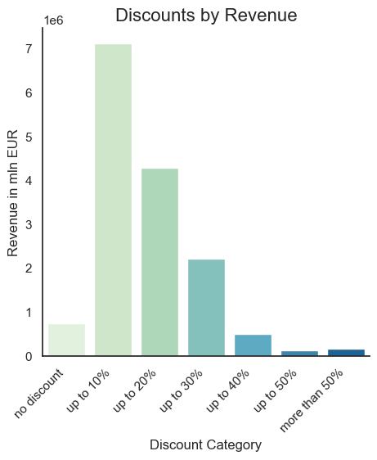
Discounts
93.1% of all units sold were discounted (by 20.8 % on average) representing 95.0% of total revenue.
High discounts do not directly result in high revenues, indicating they are not applied to high-value-products
General Effects of high discounts on low-value-products hard to assess:
No data regarding stock-reduction
No data on customers
No data on shop-traffic
Fitting a premium accessory-provider?

Slide 5
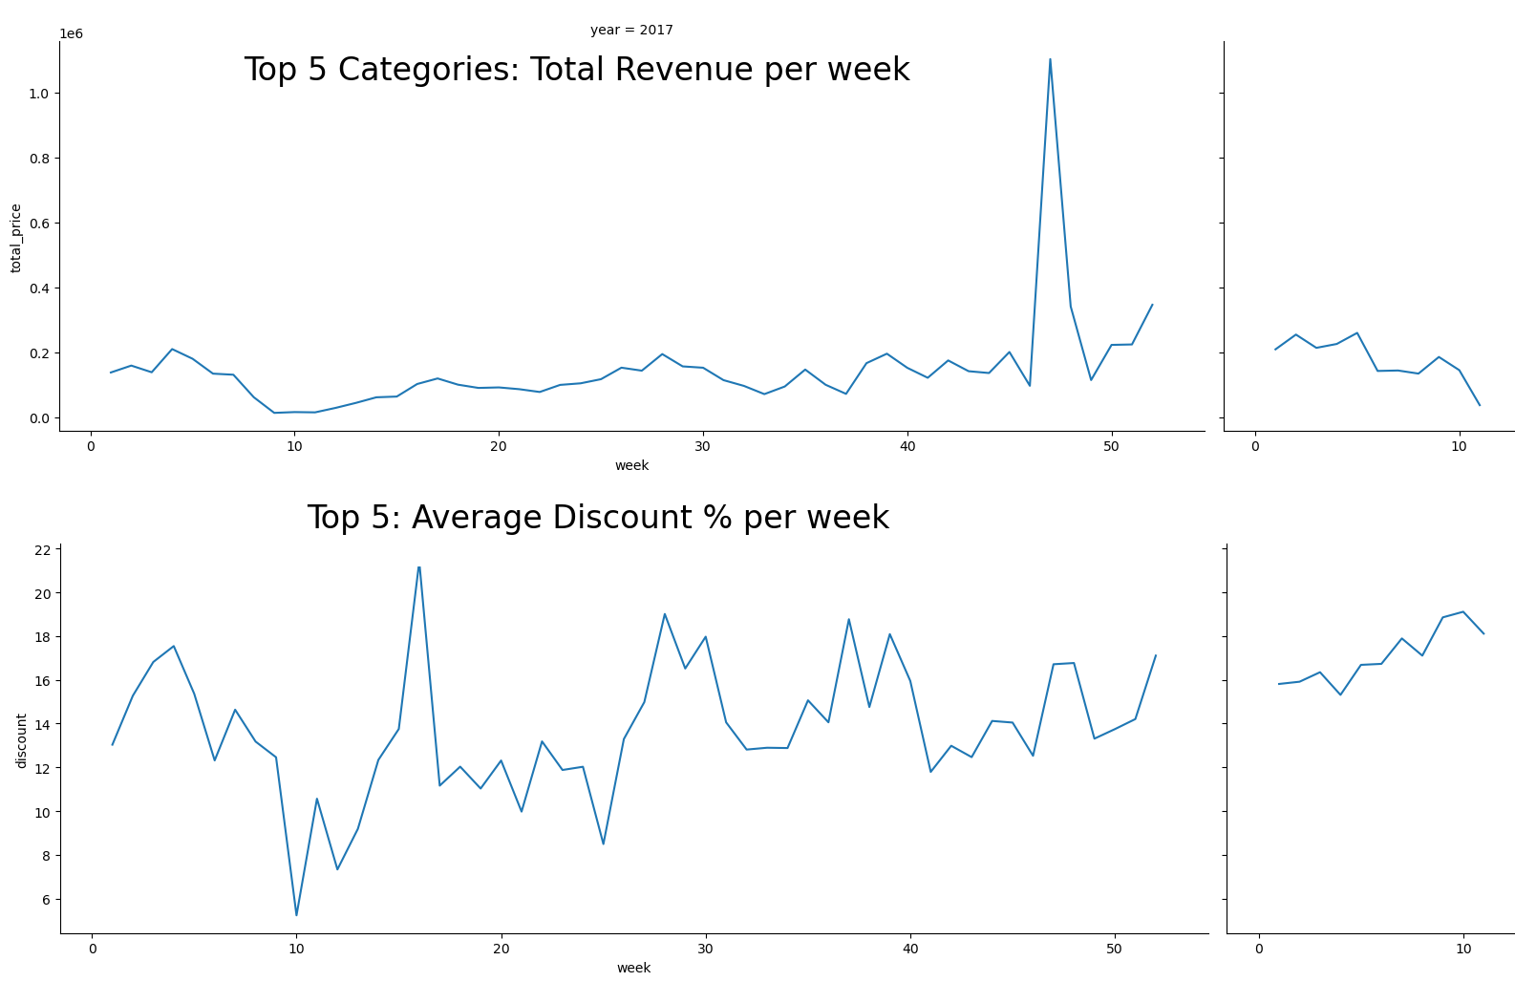
Discounts in Top-Categories
Why?
Main revenue-drivers
Key Findings:
No Obvious Pattern
Fluctuation of discounts rather low
Limitations:
When excluding the end-of-year-peak in revenues, there might be a small correlation
In-depth statistical analysis might give insights
did not happen due to time constraints

Slide 6
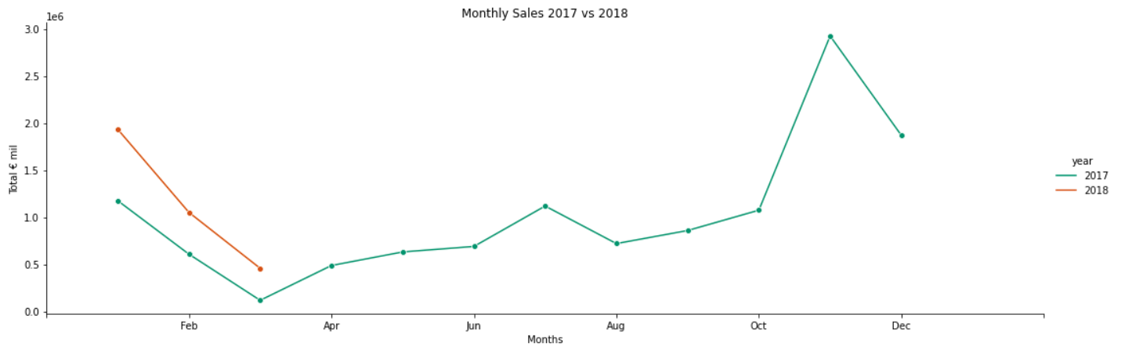
Seasonality
Black Friday driving peak in sales
Xmas continues to drive increased sales
Comparing Q1 Sales from 2017 vs 2018:
2018 Sales Stronger
Increases Market Awareness
Could be due to increased traffic over Black Friday and Xmas
Could this be driven by promotions?
Notes:
Reviewing total sales by month we can see strong peaks for black friday and string sales in december for christmas
As we have discounts all year round it looks like these peaks are driven by seasonality and not mainly by discounts
However looking at comparing Q1 sales for 2017 vs 2018 we can see that we have increased sales
This could be due to increased traffic over Black Friday and Xmas increasing market awareness
we are not able to conclude if this is due to promotions

Slide 7
Limitations / Data Collection Improvements
Unaware of the Company Goals:
Build Market Awareness
E.g. Is there a need to drive increase traffic to site to build brand awareness?
Are they a new company?
Trying to acquire the customer base
Missing Information:
Profits / Cost Price / Margins
Although we can see peak in revenue we are unaware on how discounts are impacting company profits.
Customer Information
We do not have customer information therefore we cannot see if they are returning or being driven to the site with discounts.
Data Collection Improvements:
Prices
To be rejected if entered incorrectly (with two decimals)
Remove/ Reject Duplicates
When updating product-portfolio
Datetime-Format
Automatically import date-inputs as datetime-format
Column Names
Columns to have the same name if they contain the same information
Database
Data to be in a Database not in 4 CSV files

Slide 8
It is Beneficial to Discount Products?
After cleaning and reviewing the dataset provided we are unable to advice if it is beneficial to discount products due to limitations in the data:
Peaks in revenue are not mainly driven by discounts
Assessing the beneficiality is difficult because we do not know the overall strategy of the company
We are unaware of the impacts discounting is having on company profits
Since the dataset shows discounts over the whole time frame it’s not possible to assess what would happen if we were not discounting or only discounting on special occasions

Slide 9
Any Questions?

